Slide 1
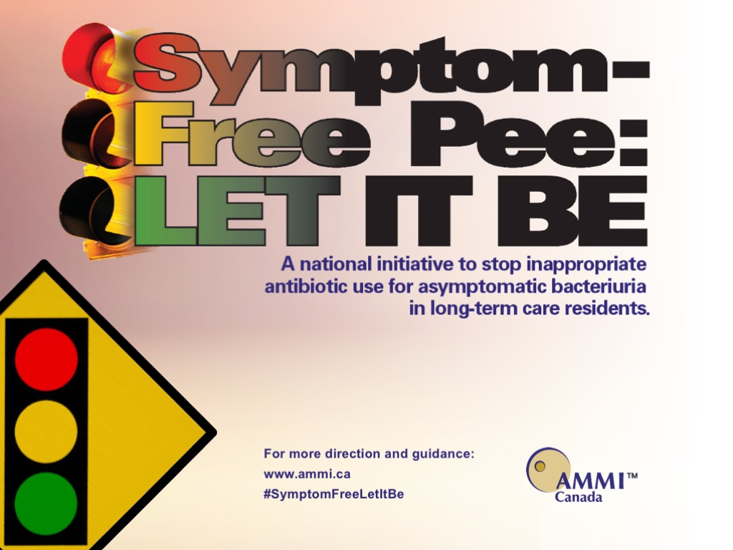

Slide 2
Asymptomatic Bacteriuria Campaign - Acknowledgements
Association of Medical Microbiology and Infectious Disease (AMMI) Canada
Antimicrobial Stewardship and Resistance Committee (ASRC)
Chair – Andrew Morris Vice-Chair – Edith Blondel-Hill
ASRC Asymptomatic Bacteriuria Subcommittee
Kim Abbass
Edith Blondel-Hill
Gregory German
Tim Lau
Caroline Nott
David Patrick
Geneviève Soucy
We thank the AMMI Canada Council and Secretariat for their support.

Slide 3
Asymptomatic Bacteriuria
Definition
The presence of a significant colony count of bacteria recovered from a urine sample in a person without any signs or symptoms associated with a urinary tract infection.
Clin Infect Dis 2005;40:643-54

Slide 4
Asymptomatic Bacteriuria
More common in seniors > 65 years
20% in females / 10% in males
(1 - 3% in younger population)
Increases with age > 80 years
Up to 50% in females
Up to 30% in males
Nicolle LE. Infect Dis Clin North Am 1997;11(3):647-62
Nicolle LE. Infect Control Hosp Epidemiol 2001;22(3):167-75
Notes:
Nicolle LE. Asymptomatic bacteriuria in the elderly. Infect Dis Clin North Am 1997;11(3):647-62.
Nicolle LE. Urinary tract infections in long-term-care facilities. Infect Control Hosp Epidemiol 2001;22(3):167-75.

Slide 5
Asymptomatic Bacteriuria
Depends on place of residence
Hospital > nursing home > home
Increased incidence with longer stay
Elderly institutionalized (no indwelling catheter)
Females - 25-50%
Males - 15-49%
Nicolle LE. Infect Dis Clin North Am 1997;11(3):647-62
Nicolle LE. Infect Control Hosp Epidemiol 2001;22(3):167-75
Notes:
Nicolle LE. Asymptomatic bacteriuria in the elderly. Infect Dis Clin North Am 1997;11(3):647-62.
Nicolle LE. Urinary tract infections in long-term-care facilities. Infect Control Hosp Epidemiol 2001;22(3):167-75.

Slide 6
Asymptomatic Bacteriuria
Predisposing factors in the elderly:
      Diabetes
      Immobility
      Incontinence
      Prostatic enlargement
      Post-menopausal changes
Nicolle LE. Infect Dis Clin North Am 1997;11(3):647-62
Nicolle LE. Infect Control Hosp Epidemiol 2001;22(3):167-75
Notes:
Nicolle LE. Asymptomatic bacteriuria in the elderly. Infect Dis Clin North Am 1997;11(3):647-62.
Nicolle LE. Urinary tract infections in long-term-care facilities. Infect Control Hosp Epidemiol 2001;22(3):167-75.

Slide 7
Asymptomatic Bacteriuria
Asymptomatic bacteriuria is NOT associated with long term negative outcomes such as:
      Pyelonephritis
      Sepsis
      Renal failure
      Hypertension
Nicolle LE. Infect Dis Clin North Am 1997;11(3):647-62
Notes:
Nicolle LE. Asymptomatic bacteriuria in the elderly. Infect Dis Clin North Am 1997;11(3):647-62.
Nicolle LE. Urinary tract infections in long-term-care facilities. Infect Control Hosp Epidemiol 2001;22(3):167-75.

Slide 8
Practice Points
Asymptomatic bacteriuria is a colonization state NOT an infection
  Antibiotics are NOT indicated
Bacteriuria and pyuria are expected findings in the elderly
Symptomatic UTI is much less common than asymptomatic bacteriuria
Nicolle LE. Infect Dis Clin North Am 1997;11(3):647-62
Nicolle LE. Infect Control Hosp Epidemiol 2001;22(3):167-75
Notes:
Nicolle LE. Asymptomatic bacteriuria in the elderly. Infect Dis Clin North Am 1997;11(3):647-62.
Nicolle LE. Urinary tract infections in long-term-care facilities. Infect Control Hosp Epidemiol 2001;22(3):167-75.

Slide 9
Signs and Symptoms Suggestive of Urinary Tract Infection
Dysuria - pain or burning on urination
Increased frequency of urination
Urgency
Suprapubic tenderness
Costovertebral tenderness or pain
Non-specific signs/symptoms that may or may not indicate a urinary tract infection:
Fever*
Hematuria- blood in urine*
Cognitive changes*
* These alone are insufficient to diagnose a urinary tract infection
CDC 2014: CDC/NHSN surveillance definitions for specific types of infections

Slide 10
Signs that are NOT Suggestive of Urinary Tract Infection
Change in urine colour – dark
Change in urine odour – foul-smelling
Change in urine turbidity – cloudy urine
Do NOT perform urinalysis or send urine culture

Slide 11
Signs & Symptoms NOT Suggestive of Urinary Tract Infection
The following are NOT typically associated with a urinary tract infection:
Dizziness
New or increased falls
Decreased appetite
Altered behaviour:
  New or increased verbal or physical aggression
  Confusion/disorientation
  New or increased wandering
  Disorganized thinking
Nicolle LE. Clin Geriatr Med 2009;25:423–36.
Nicolle LEJ Am Geriatr Soc 2009;57:1113–4.

Slide 12
Seniors or Catheterized Patients with
Non-Specific Symptoms / Signs
→ Essential to exclude all other potential causes
  Dehydration
  New medications/drug interactions
  Sleep disturbances
  Sensory deprivation
  Trauma
  Hypoxia
  Hypoglycemia
  Infection other than urinary tract infection

Slide 13
Dipsticks
No longer recommended in long-term care facilities
Positive for both bacteriuria and pyuria:
Approximately 50% non-catheterized
Approximately 100% catheterized
Genao L, Buhr GT.Ann Long Term Care 2012;20(4):33-8
Public Health Ontario- August 2016:UTI Program: Evidence to support discontinuing the use of dipsticks to diagnose urinary tract infections in residents of long term care homes – August 2016

Slide 14
Urinalysis and Urine Cultures
NOT recommended for:
  Change in colour / odour of urine in absence UTI symptoms
  Blocked catheter
  Replacement/insertion of catheter
  Test of cure - unless patient not responding to proven UTI
  Standing order
  Routine screen except:
    During pregnancy
    Prior to genital urinary procedure

Slide 15
Urinalysis and Urine Cultures
Send only if strong clinical suspicion of UTI
UTI is NOT a laboratory based diagnosis
Urine culture is performed to:
Identify uropathogen(s)
Guide antibiotic therapy

Slide 16
Urine Cultures
Positive urine culture:
Cannot differentiate between asymptomatic bacteriuria (ASB) and urinary tract infection (UTI)
Asymptomatic bacteriuria:
  Should NOT be investigated or treated except:
    During pregnancy
    Prior to genitourinary instrumentation/surgery

Slide 17
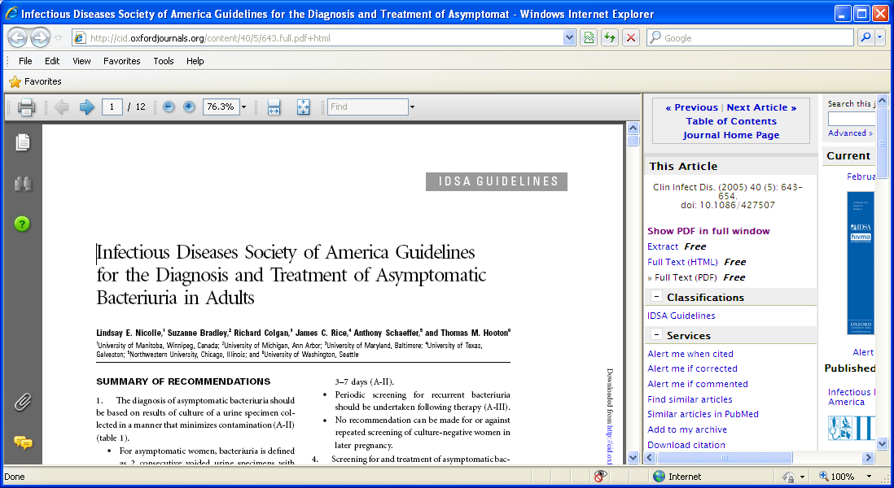
Screening for or treatment of asymptomatic bacteriuria NOT recommended:
Premenopausal, non-pregnant women
Diabetic women
Older persons living in the community
Elderly, institutionalized subjects
Persons with spinal cord injury
Catheterized patients while catheter remains in situ
Nicolle et al. Clin Infect Dis 2005;40:643-54

Slide 18
Top Ten Myths Regarding the Diagnosis and Treatment of Urinary Tract Infections
Lucas Schulz et al- J Emerg Med. 2016;51(1):25-30.

Slide 19
Myth: Urine is cloudy and smells bad - Patient has UTI
Visual inspection not helpful
Study of 100 female patients
  Sensitivity of turbidity -13.3%
Foley A, French L. J Am Board Fam Med
Foul-smelling - unreliable indicator
Usually dependent on patient’s hydration status and concentration of urea in urine
Nicolle LE. Infect Control Hosp Epidemiol 2001;22:316–21.
Nicolle LE, et al Clin Infect Dis 2005;40:643–54.

Slide 20
Myth: Urine is positive for leucocyte esterase- need to perform urine culture
Using pyuria or bacteriuria alone:
Overtreatment rate of up to 47%
Urine white blood cell counts vary depending on hydration
May also be elevated:
Hematuria of non-infectious cause
Acute renal failure
Sexually transmitted diseases
Non-infectious cystitis
Lammers RL et al. Ann Emerg Med 2001;38:505–12

Slide 21
White Blood Cells (Leucocytes) in Urine - Pyuria
  Present in UTI
  Present in up to 90% of patients with asymptomatic bacteriuria
  Present in 30% patients in LTC with no bacteriuria
  Absence essentially rules out UTI
  Presence NOT diagnostic for UTI
Poor positive predictive value: 18-75%
Juthani-Mehta M, et al. Infect Control Hosp Epidemiol 2007;28(7):889-91
Nicolle LE; Infect Control Hosp Epidemiol 2001;22(3):167-75
Notes:
Juthani-Mehta M, Tinetti M, Perrelli E, et al. The role of dipstick testing in the evaluation of UTI in nursing home residents. Infect Control Hosp Epidemiol 2007;28(7):889-91.

Slide 22
Myth: Urine has nitrates present - Patient has UTI
Urine nitrate has high predictive value for bacteriuria but:
Not all bacteria positive for nitrate test
  Pseudomonas spp
  Enterococcus spp
Many elderly have asymptomatic bacteriuria
Combination of negative leucocyte and negative nitrate:
Good to rule out UTI
  Negative predictive value - 88%
Deville WL, et al. BMC Urol 2004;4:4

Slide 23
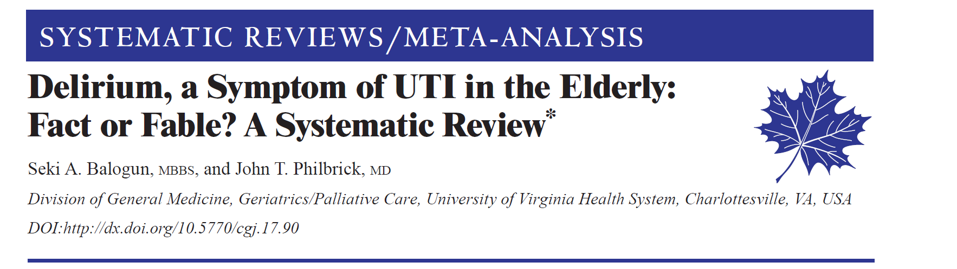
Poorly studied - 5 studies
None had objective criteria for diagnosis of UTI or delirium
Only 2 studies adequately matched to make comparisons
Basically:
Patients with delirium: UTI rates 26 - 32%
Patients with UTI: delirium rates 30 - 35%
  Compared to 8% without delirium
Balogun SA. Canadian Geriatrics Journal 2014; 17:22-26

Slide 24
Residents with Non-Specific Symptoms
  Hemodynamically stable resident:
  No evidence of increased morbidity or mortality associated with waiting 24 hrs to reassess for:
  Non-specific symptoms improvement
      or
  Development of typical symptoms
Beveridge LA et al Clin Interv Aging 2011;6:173–80.
Nicolle LE. CMAJ 2000;163:285–6.
Notes:
Additional information:
Non-specific symptoms in the absence of clinical signs of infection should be discussed with the physician.

Slide 25
Residents with Non-Specific Symptoms
  Non-specific symptoms:
    Acute mental status change
    Functional decline
  → Often resolve with good hydration
  Push fluids for 24 hours and reassess
Beveridge LA et al Clin Interv Aging 2011;6:173–80.
Nicolle LE. CMAJ 2000;163:285–6.
Notes:
Additional information:
Non-specific symptoms in the absence of clinical signs of infection should be discussed with the physician.

Slide 26
Asymptomatic Bacteriuria
80% of asymptomatic bacteriuria patient receive antibiotics
1/3 of antibiotics in LTC for asymptomatic bacteruria
CDC study:
  Antibiotics for UTI avoidable in 39% of patients
Trautner BW. Asymptomatic bacteriuria: When the treatment is worse than the disease. Nat Rev Urol.2012;9:85-93
Fridkin S, Baggs J, Fagan R, et al. Vital signs: improving antibiotic use among hospitalized patients. MMWR Morb Mortal Wkly Rep 2014;63:194–200.

Slide 27
Asymptomatic Bacteriuria
Inappropriate antibiotic treatment will cause:
  Unnecessary adverse effects to the patient
    C. difficile infection (CDI)
    Drug interactions
  Increase in antibiotic resistance
  Increased healthcare costs

Slide 28
Reducing Antimicrobial Therapy for Asymptomatic Bacteriuria
  University of Toronto
  Stopped reporting urine cultures on hospitalized non-catheterized patients from medical/surgical floors
  6 month period (Jan-Jun 2013)
  Catheterized patient- controls
  Antibiotic treatment for ASB:
  Baseline
  Non-catheterized patient: 48% vs catheterized: 42%
  After intervention of modified reporting:
  Non-catheterized: 12% vs catheterized: 41%
  4 UTIs in non-catheterized patients- all started on empiric therapy
  Physician called for results: 5/37 reports
      1/5 - UTI vs 4/5- ASB
  Leis JA. et al. CID 2014:58(7);980-3

Slide 29

Antimicrobial Resistance
  2050 - more people will die from antimicrobial resistance than cancer and diabetes combined

Slide 30
Asymptomatic Bacteriuria
Practice Points:
Foul-smelling and cloudy urine typically indicate dehydration, NOT urinary tract infection
Culturing urine specimens based on dipstick / positive urinalysis is NOT recommended due to its poor predictive value in the elderly
Symptomatic UTI is substantially LESS COMMON than asymptomatic bacteriuria in long-term care
Treatment of asymptomatic bacteriuria DOES NOT alter clinical outcome but results in adverse events and promotes antimicrobial resistance

Slide 31

Asymptomatic Bacteriuria Campaign…
Symptom-Free Pee: LET IT BE
Antibiotic Awareness Week in Canada
(November 14-20, 2016)
For more direction and guidance, visit:
ammi.ca/AntibioticAwareness
#SymptomFreeLetItBe

Slide 32

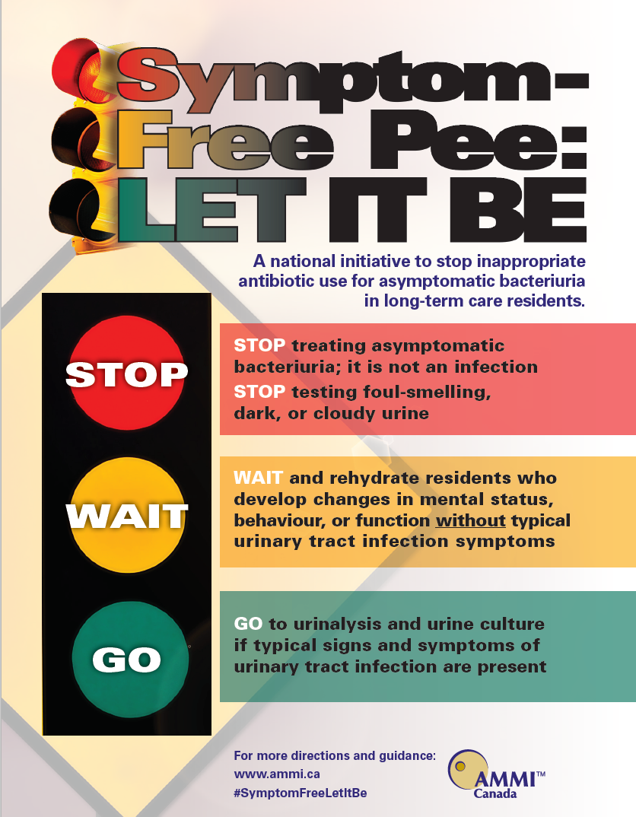
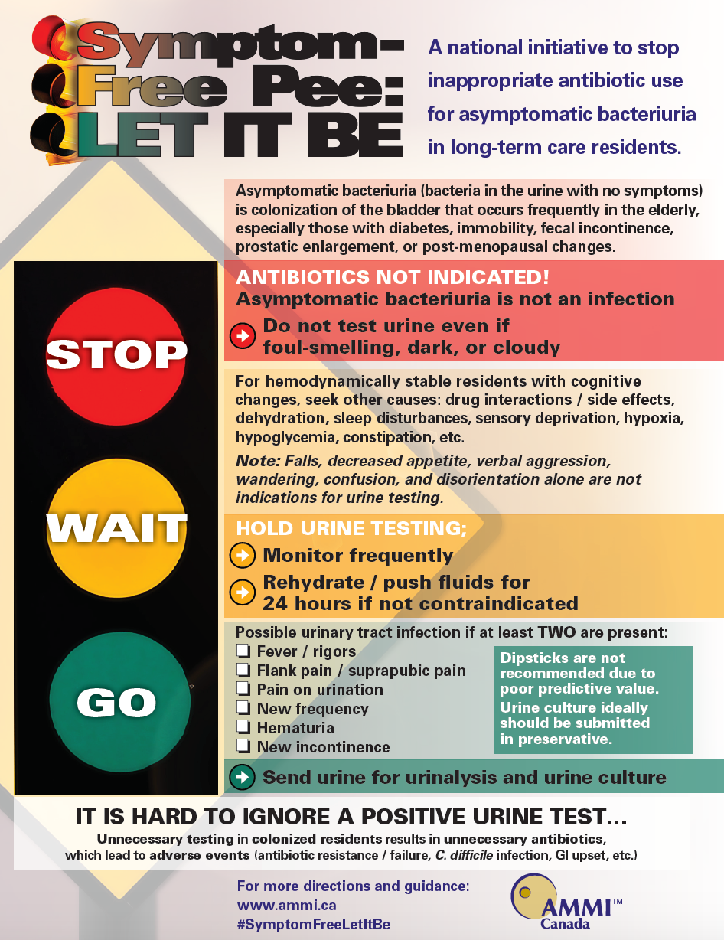
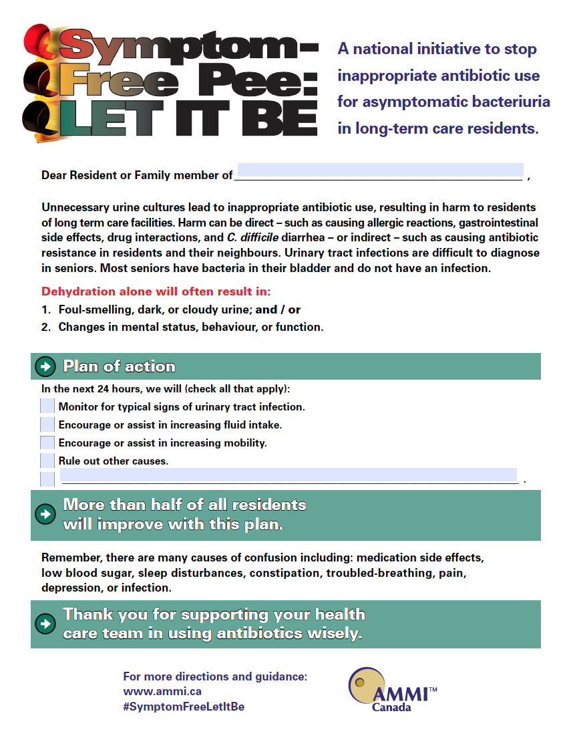
Symptom-Free Pee: LET IT BE
A national initiative to stop inappropriate antibiotic use for asymptomatic bacteriuria in long-term care residents.
Asymptomatic Bacteriuria Toolkit:
PLUS:
A repository of regional toolkits, algorithms, medical directives and initiatives
Slideshow
Fillable Resident/
Family Letter
Poster Downloads
ammi.ca/AntibioticAwareness #SymptomFreeLetItBe

